Slide 1
Introduction

Slide 2





$$α$$
$$mg$$
$$R$$
$$θ$$
$$P$$

Slide 3


x
θ
$$v=r\dot{θ}$$
mg
τ
l
r
r
θ
f_{f}
x
mg
x
θ
θ
mg
b$\dot{θ}$
mg
τ
l
r
r
f_{f}
θ
f_{f}
mg
mg

Slide 5
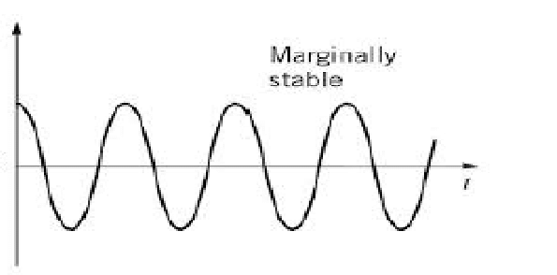



$$θ(t)$$
$$t$$

Slide 6
Hardware
Mechanical system: Drive motor, pendulum, flywheel, head servo, fabrication and materials
Electrical overview: PSoC Stick, RC receiver, MPU6050, DBH-12V motor driver, Pololu 12V DC Motor, goBilda servo, LM7805

Slide 7
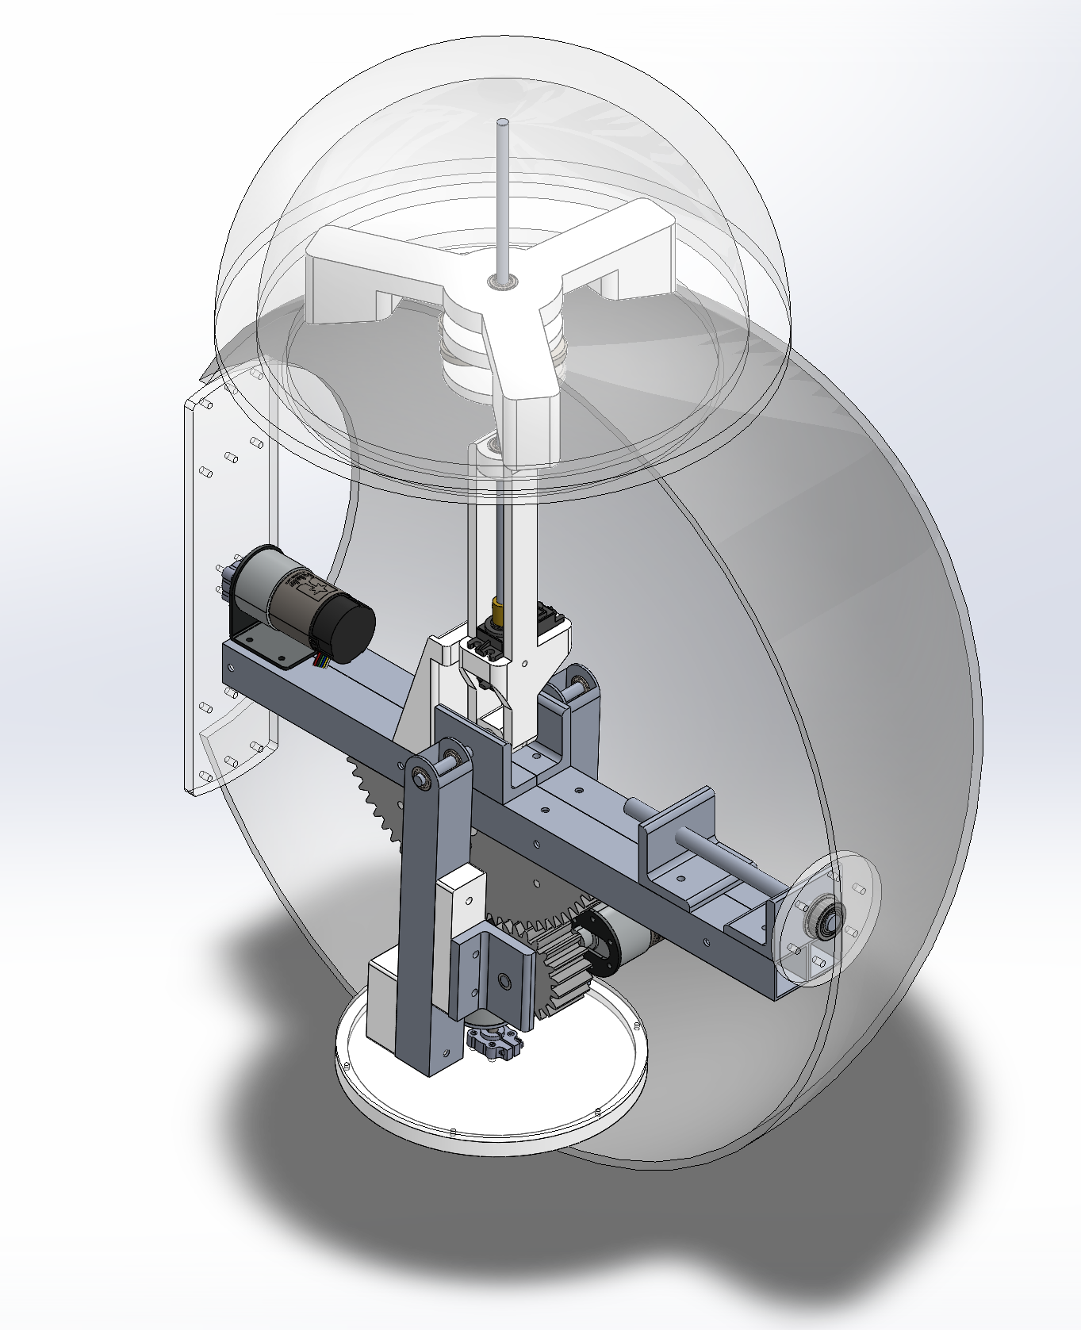
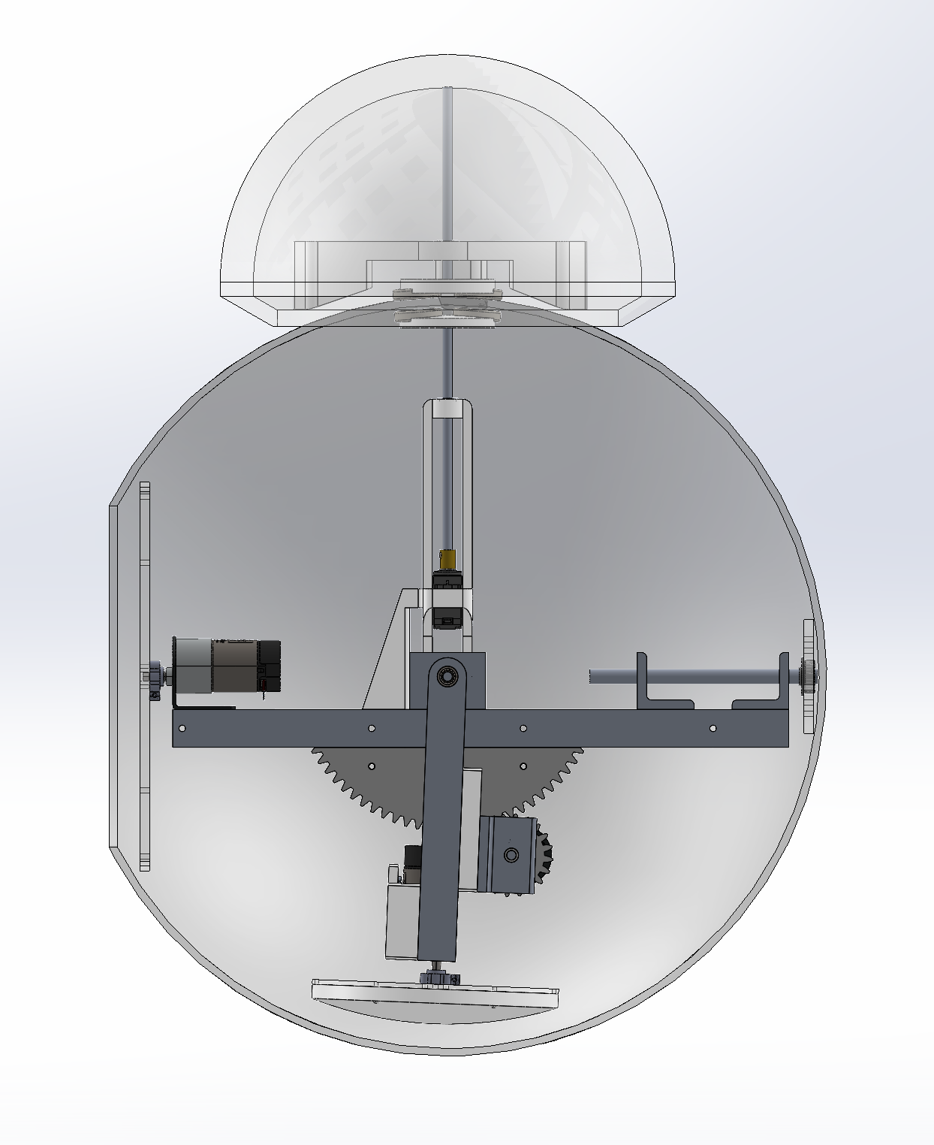

A
$$x$$

Slide 8

B
A
$$x$$
$$y$$

Slide 9

$$z$$
B
A
$$x$$
$$y$$
C

Slide 10
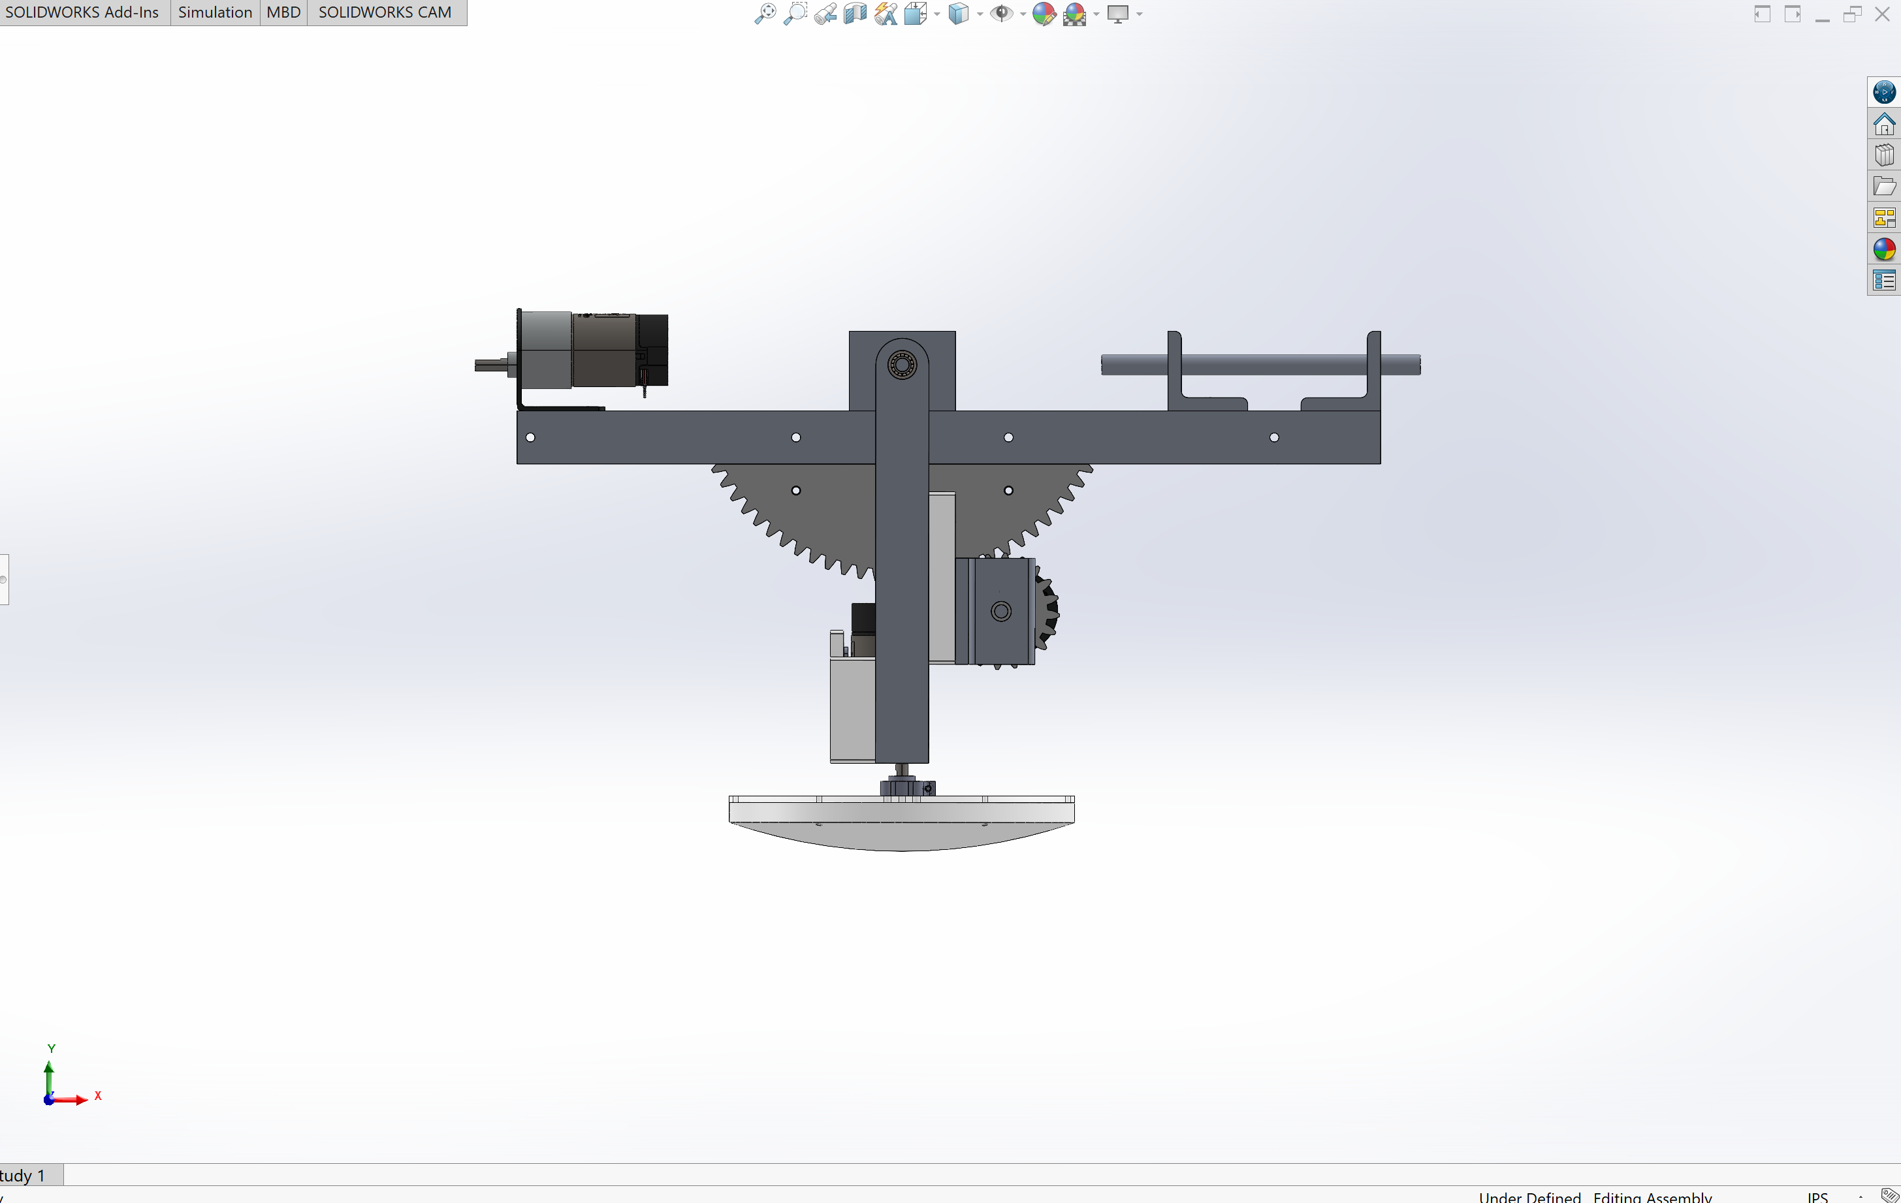

Slide 11
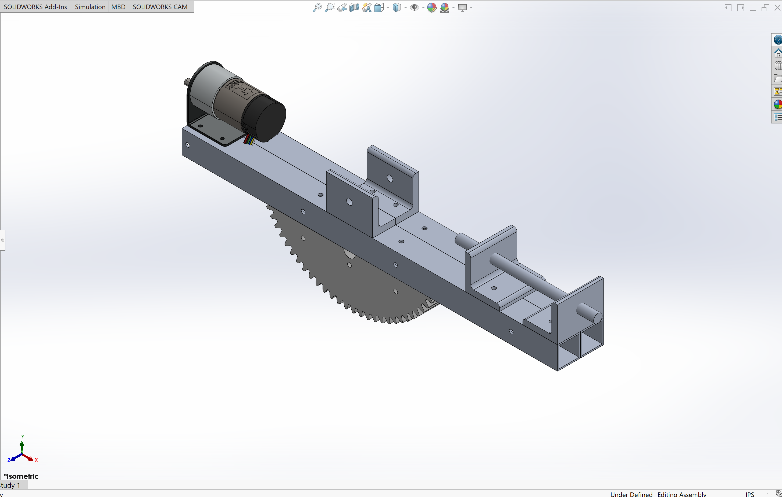

Slide 12
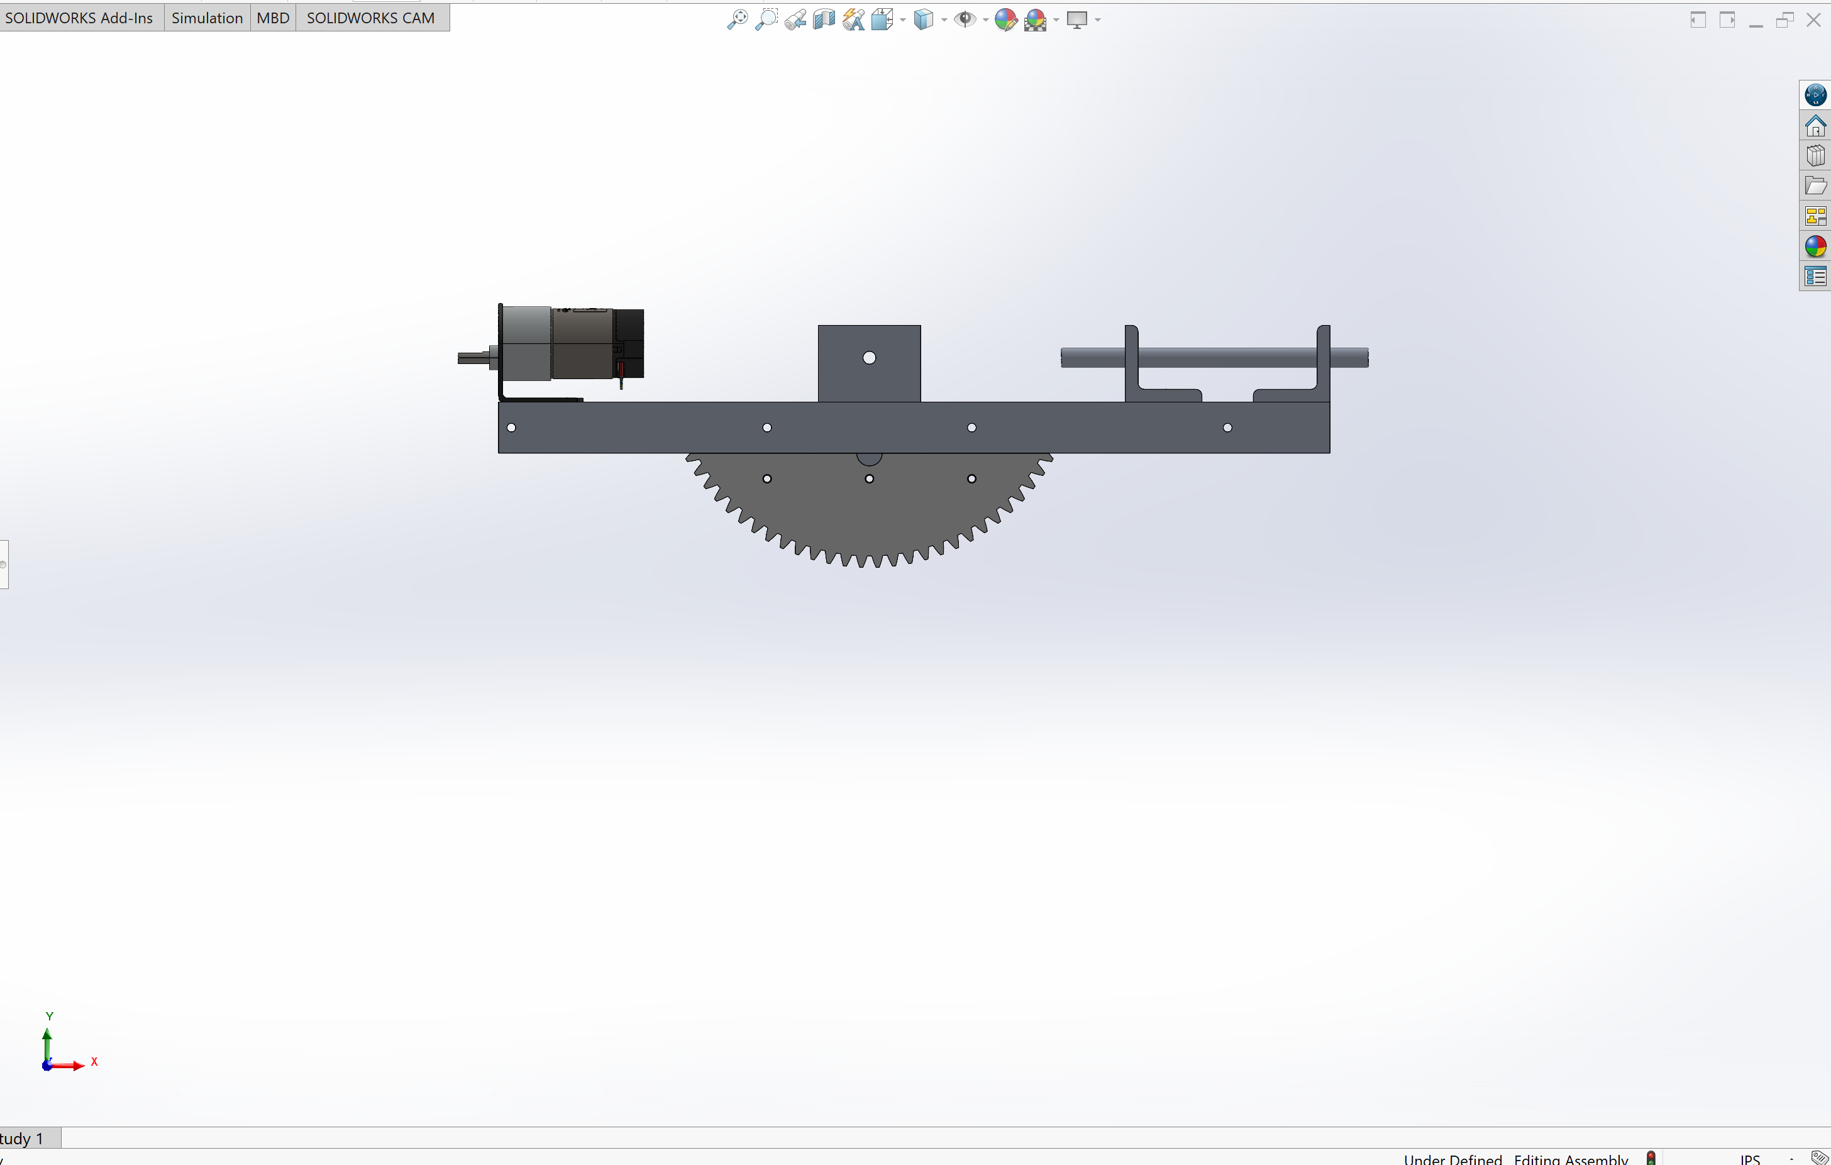

Slide 13
R₁
R₂
W_{robot}

Slide 14
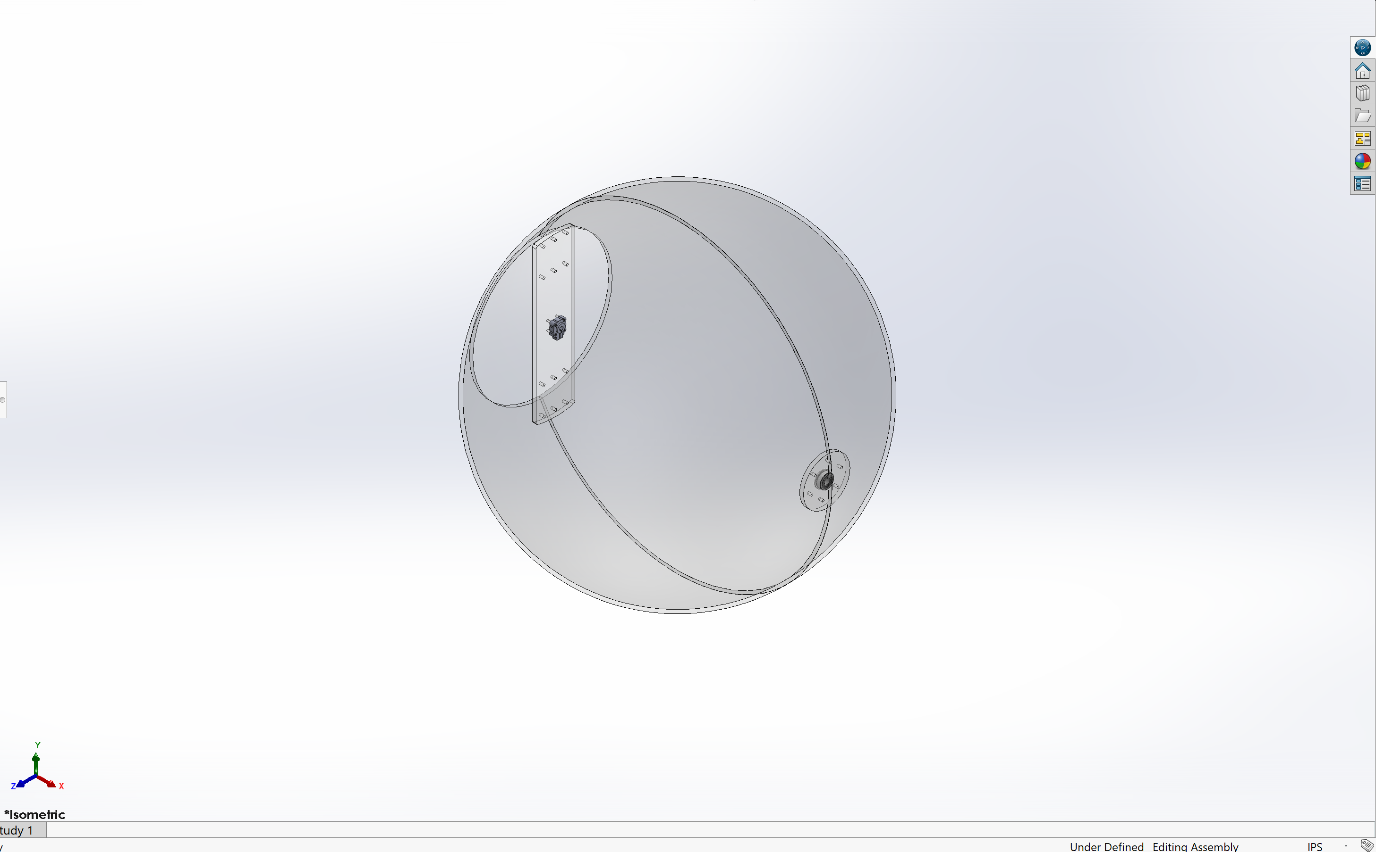

Slide 15
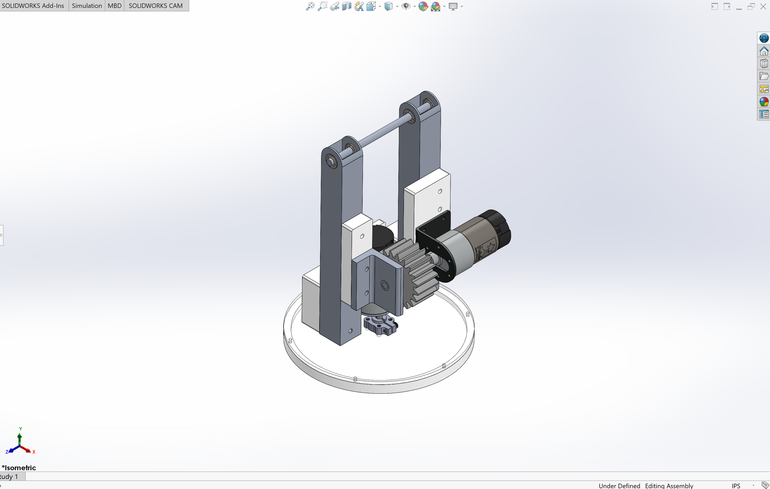

Slide 16
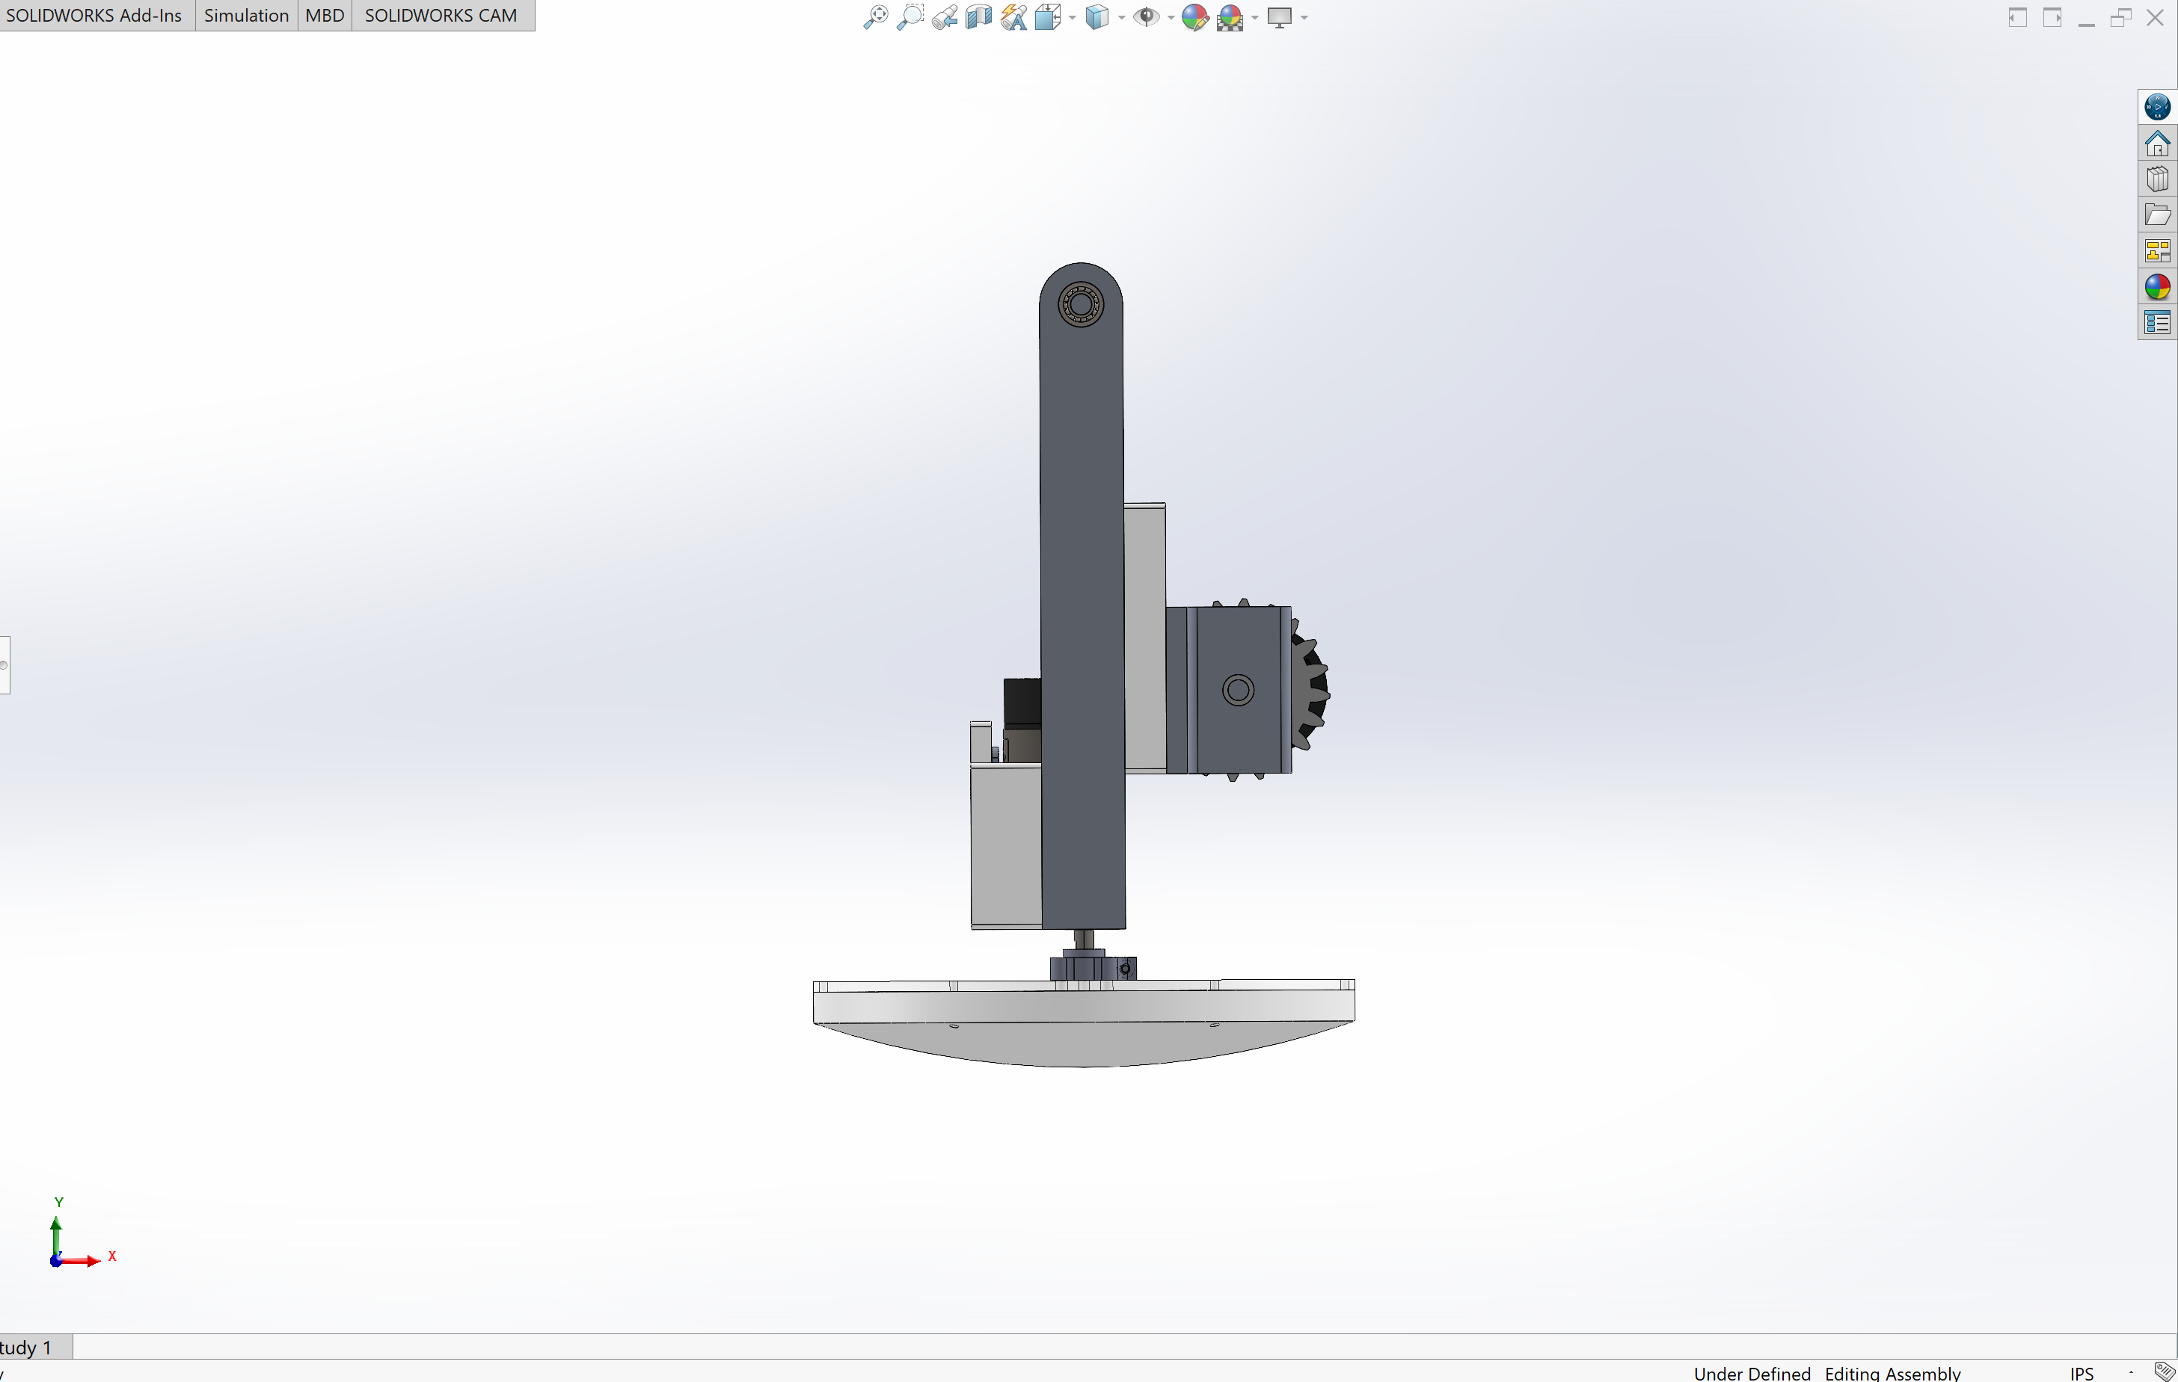

Slide 17
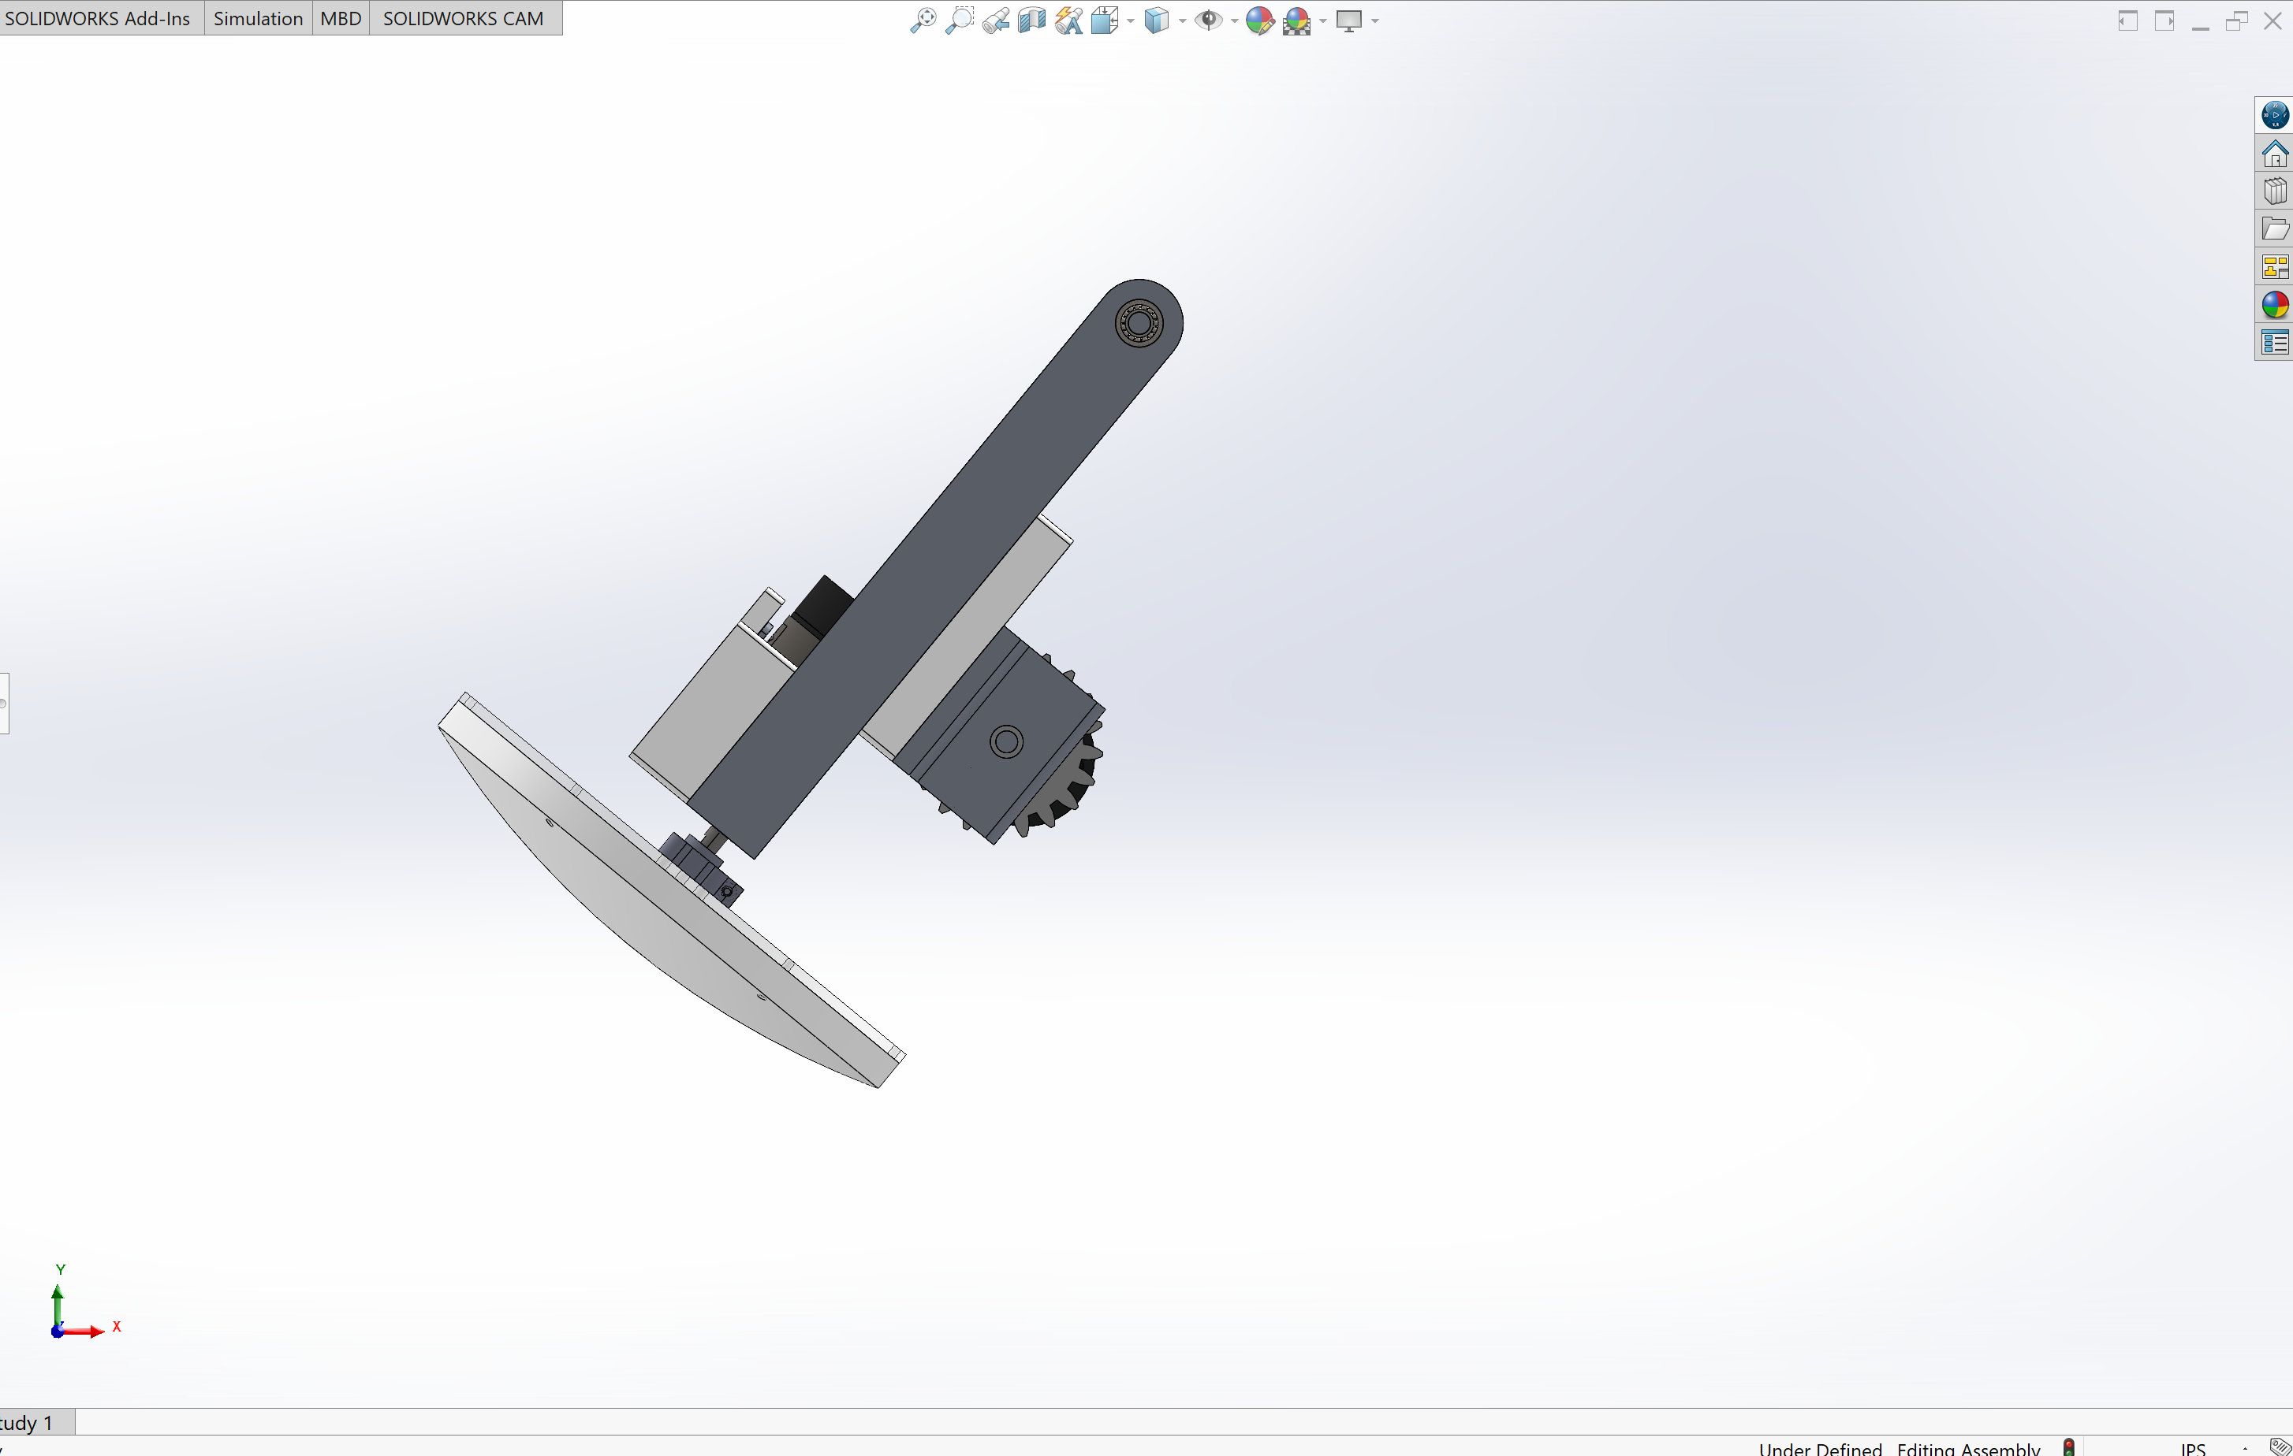

Slide 18
R_{y}
R_{x}
F_{gear}
W_{pendulum_link}
W_{flywheel}

Slide 19
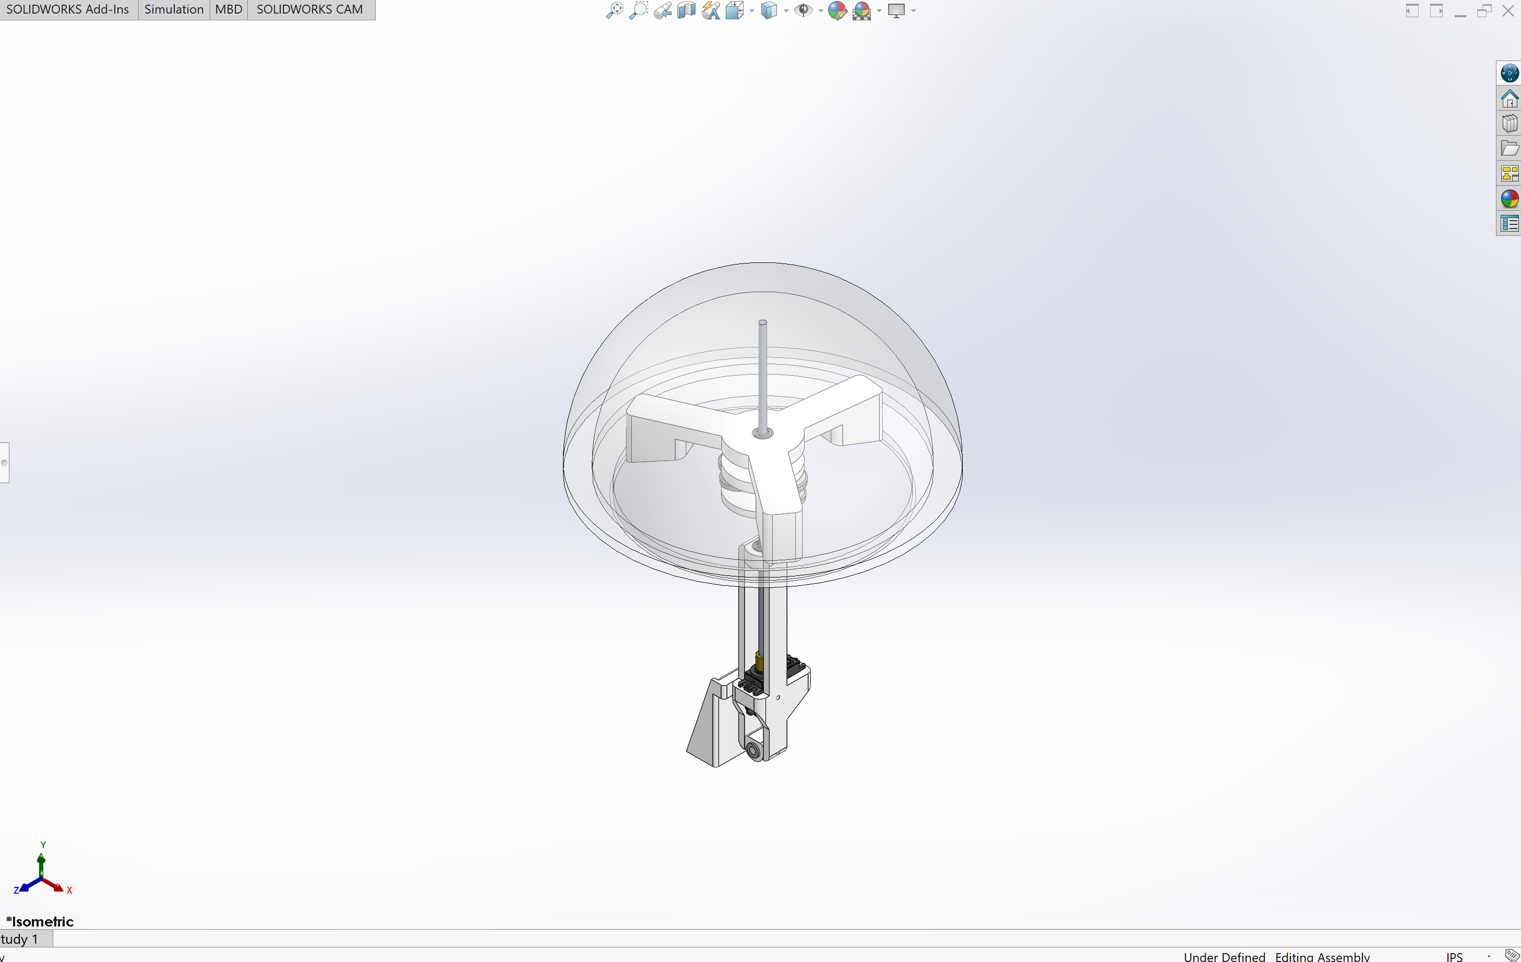

Slide 20
— Power
— Sensor I2C Input Data
— Encoder Digital Input Data
— Motor PWM Output Data
— RC Receiver PWM Input Data
MPU6050
Flysky RC Receiver
PSoC CY8C58LP
Pololu 131:1 37D 12V Gearmotor
DBH-12 Motor Driver
Pololu 50:1 37D 12V Gearmotor
goBilda 25-3 Speed Dual Mode Servo
DBH-12 Motor Driver
Pololu 19:1 37D 12V Gearmotor
12V NiMH Battery

Slide 21
— Power
— Sensor I2C Input Data
— Encoder Digital Input Data
— Motor PWM Output Data
— RC Receiver PWM Input Data
IMU
RC Receiver
PSoC Microcontroller
Central Drive 12V DC
131:1 Motor
Head Servo Motor
12V DC Motor Driver
Pendulum 12V DC
50:1 Motor
5V Linear Regulator
12V DC Motor Driver
Flywheel
12V DC
19:1 Motor
12V NiMH Battery

Slide 22
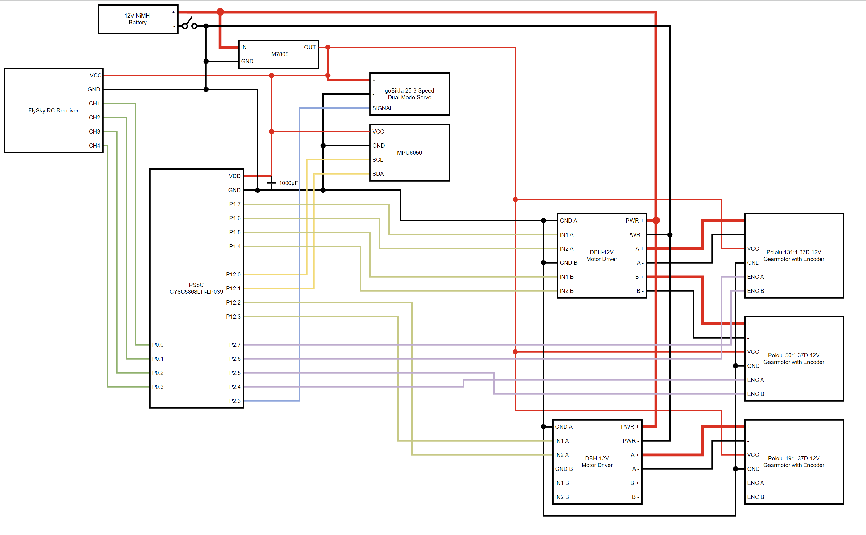

Slide 23
Software
Reading RC receiver data
Reading MPU6050 data
Writing to motors
Reading motor encoder data
PID control loops

Slide 24
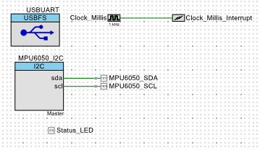
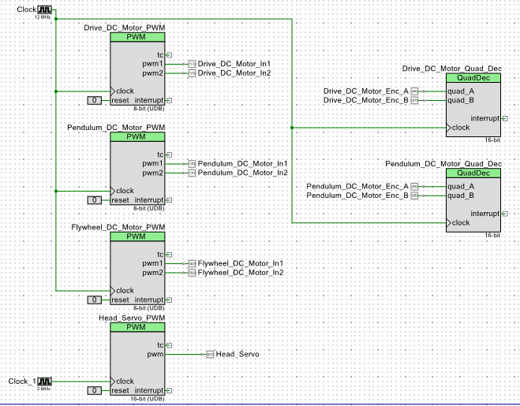
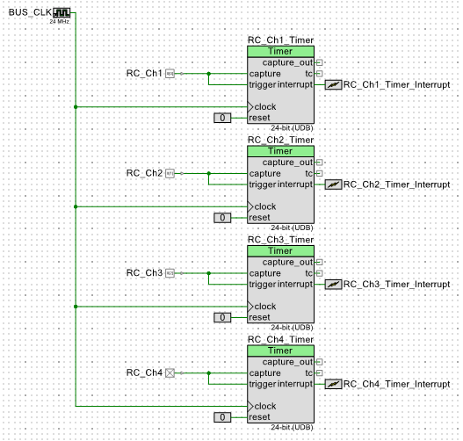

Slide 25
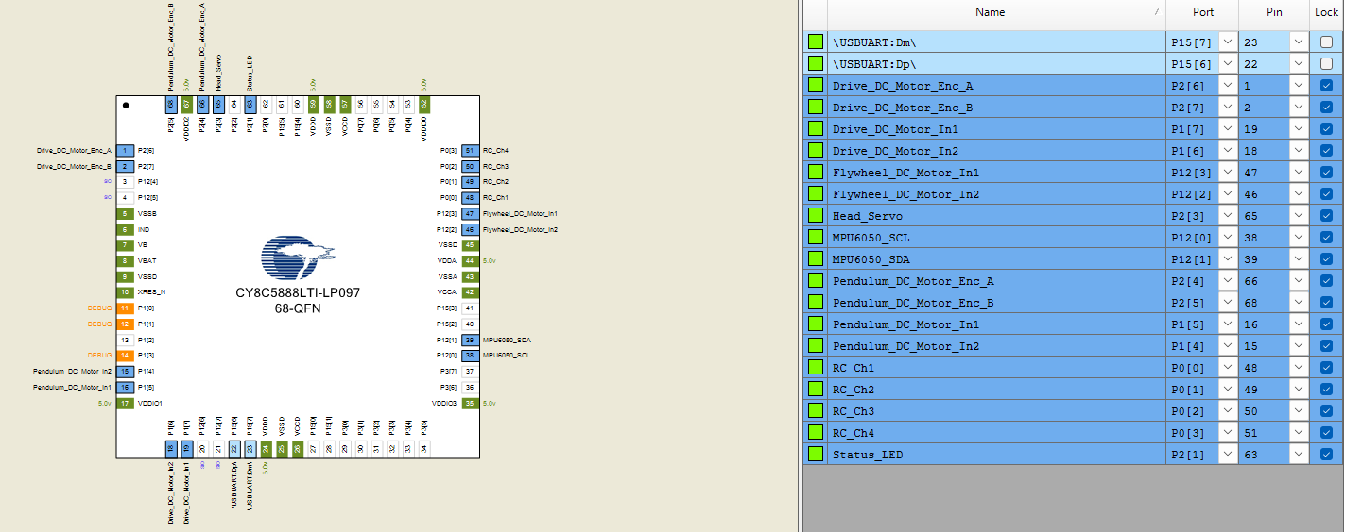

Slide 26
Read data from MPU6050
Flash status LED
1 meter traveled
Read data from RC Receiver Channels
Check drive motor encoder
1 meter not traveled
Stabilize ball with PID controller
Value is 0
Check RC Channel 2
Value is not 0
Run drive motor
Value is 0
Value is not 0
Run pendulum motor until pendulum encoder value reaches desired angle
Stabilize ball with PID controller
Check RC Channel 1
Stop flywheel motor
Value is 0
Check RC Channel 4
Value is not 0
Run flywheel motor
Stop head servo
Value is 0
Check RC Channel 3
Value is not 0
Run head servo

Slide 27
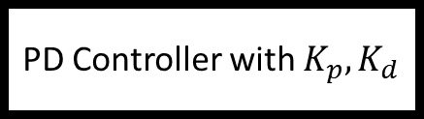
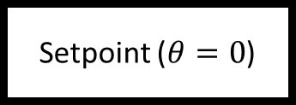

+
Setpoint ($θ=0$)
PD Controller with $K_{p}, K_{d}$
Motor PWM Output
-
IMU Data ($θ$)

Slide 28



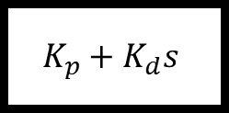


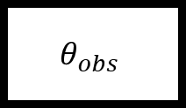
+
$$θ_{des}$$
$${e=θ}_{des}−θ_{obs}$$
$$K_{p}+K_{d}s$$
$$V_{m}$$
$$\frac{Θ\left(s\right)}{V(s)}$$
$$θ$$
-
$$θ_{obs}$$

Slide 29
